Slide 1
02 | Components
Jon Galloway | Technical Evangelist
Christopher Harrison | Content Developer
Notes:
Groupings
Labels
Panels
Jumbotron
Objects
Glyphs
Dropdowns
Buttons
Nav
Navbar
Breadcrumbs
Pagination

Slide 2
Bootstrap Components
Over a dozen reusable components built to provide iconography, dropdowns, input groups, navigation, alerts, and much more.

Slide 3
Why?
They look good
Themeable
Replacement for HTML server controls
Great for Ajax / SPA

Slide 4





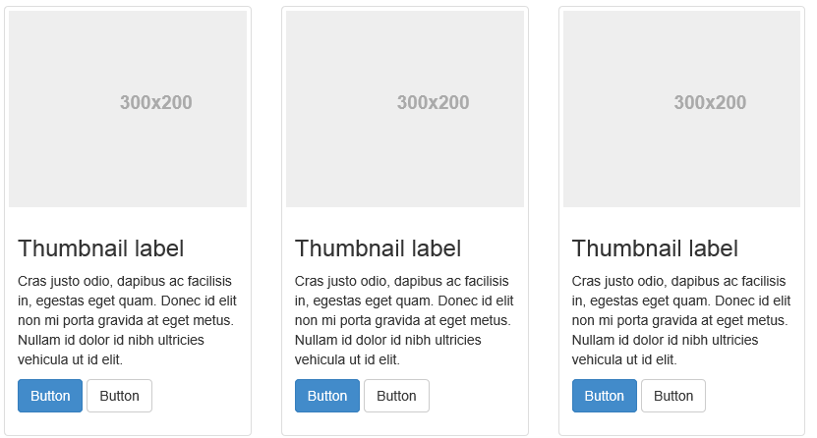
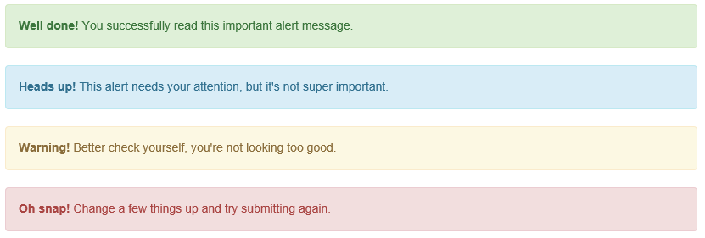
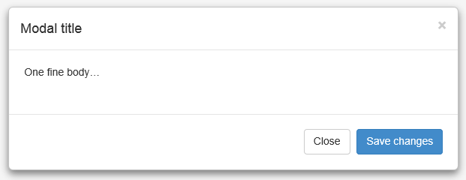
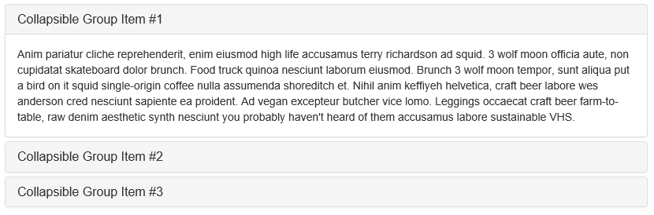
Components

Slide 5
Jumbotron
Commonly used as landing for home page
Provide key information

Slide 6
Jumbotron

Slide 7
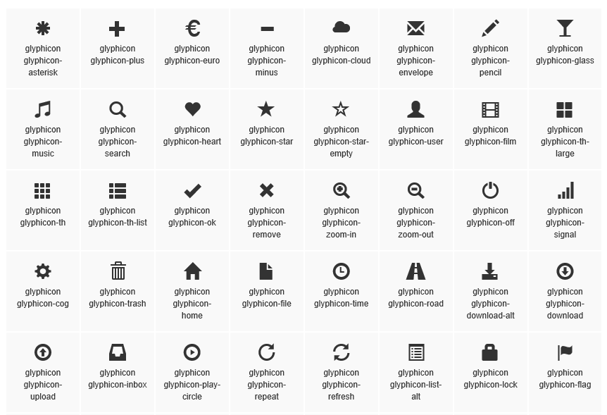
Glyphicons

Slide 8
Glyphicons

Slide 9
Badges
Provide additional information to links
Number of unread messages
Short bits of text

Slide 10
Badges

Slide 11
Thumbnails
Display groups of photos with labels
Album covers
Page previews

Slide 12
Thumbnails

Slide 13
List groups
Spruce up a standard unordered list
Better graphical interface

Slide 14
List groups

Slide 15
Panels
Used to provide context for data
Can include
Headers
Footers
Tables

Slide 16
Panels

